Slide 1

CSE3BDC/CSE5BDC
Big Data Management on the Cloud
Lecturer: Zhen He
Lecture 4

Slide 2
Lecture Outline
High level programming abstractions
  Pig
  Hive

Slide 3
Hadoop Ecosystem
What else is there in the open source Hadoop Ecosystem?
The tools in red font are the ones which we will cover in more detail.
Higher level programming abstractions
on top of MapReduce
  Pig
  Hive
  Mahout
Data Importing into HDFS
  Avro
  Sqoop
  Flume
Other tools
  Oozie
  ZooKeeper
NoSQL on Hadoop
  Hbase
Next Generation
  Interactive querying (based on Dremel)
    Impala
    Presto
    Search
  Yarn
    Storm
    Giraph
      Based on Pregal
  Berkley AmpLab
    Spark
    SparkSQL
    Spark streaming
    GraphFrames

Slide 4
Higher level programming abstractions
Pig
  A high level way of writing MapReduce programs
  A scripting language that makes MapReduce programming easy
    E.g. 400 line MapReduce code can be written in 15 lines in Pig
  Resembles relational algebra
Hive
  SQL interface to MapReduce
  Written by Facebook
Mahout
  A machine learning interface to Hadoop.
  Provides most of the tools needed to do data mining
    E.g. Classification, clustering, regression, etc.

Slide 5
More Detail
We will talk about these two higher level programming abstractions in more detail
  Pig
  Hive

Slide 6
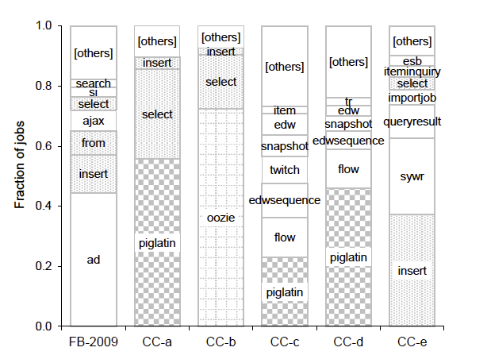

Pig and Hive used in large fraction of workload within the MapReduce framework
Empirical analysis of seven industrial MapReduce workload traces over long-durations
From the following sources
  Facebook
  e-commerce
  Telecommunications
  Media
  Retail customers of Cloudera
Over 2,000,000 jobs
Moved approx. 1.6 exabytes of data over 5000 machines
The graph shows a large fraction of jobs were written in Pig and Hive
Source: Yanpei Chen, Sara Alspaugh, Randy Katz, Interactive Analytical Processing in Big Data Systems: A Cross-Industry Study of MapReduce Workloads, VLDB 2012

Slide 7
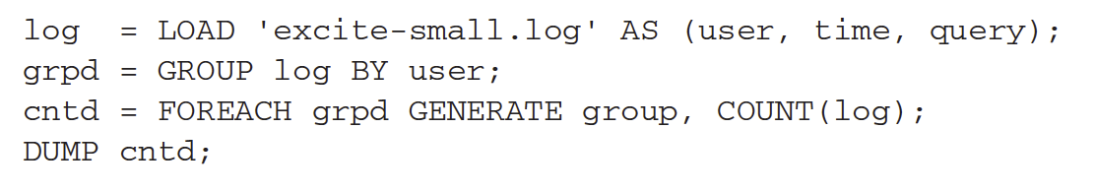
Pig
Created by Yahoo! To make data processing easier over MapReduce
40% of Hadoop jobs in Yahoo! are Pig
Twitter is another big Pig user
Much easier to program than MapReduce
Uses a language called Pig Latin to express data flows.
A Pig Latin program is made up of a series of operations or transformations applied on the input data.
Operations as a whole describe a data flow.
Pig turns transformations into a series of MapReduce jobs.
You can find research paper on Pig here
  Christopher Olston, Benjamin Reed, Utkarsh Srivastava, Ravi Kumar, Andrew Tomkins, Pig Latin: A Not-So-Foreign Language for Data Processing, ACM SIGMOD 2008

Slide 8
Translation into MapReduce
Foreach grpd
Generate group, COUNT(log)
Load log
Group by user
Map
Reduce
The above shows the Pig Latin script being translated into a Map and a Reduce task
In general a Pig script can be translated into any number of Map and Reduce scripts.

Slide 9
Hive

Slide 10
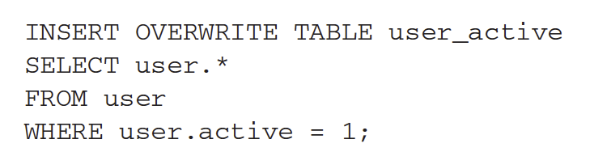
Hive
A data warehouse package built on top of the MapReduce framework of Hadoop
Began in Facebook
Now an open source subproject of Hadoop
Target users
  Data analysts who want to write ad-hoc SQL queries over massive data sets.
Hive provides SQL-like language
E.g. to get all active users from a user table you write the following:
Hive was first introduced in the following paper:
  Ashish Thusoo, Joydeep Sen Sarma, et. al.,Hive – A warehousing Solution Over a Map-Reduce Framework, VLDB 2009.

Slide 11
Hive
Big difference between Pig and Hive is that Hive requires the definition of a schema
Hive uses relational database concepts of tables, rows, columns.
Hive uses the important metastore to store schema information.
The metastore typically resides in a relational database
The query language used by Hive is called HiveQL

Slide 12
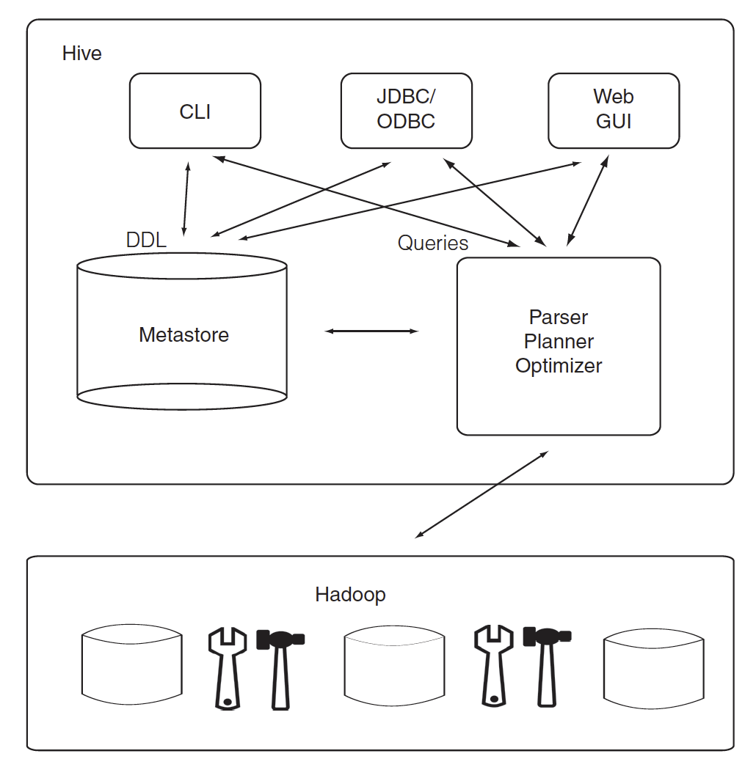
Hive Architecture
There are three ways of interacting with Hive
  Web GUI
  Java Database Connectivity (JDBC)
  Command line interface (CLI)
    The most popular way.
Queries are parsed and executed on Hadoop
The metastore stores the table schema and other metadata
  It is important in determining how queries will be run.
The metastore is a single point of failure.
  Need to make sure data can be recovered or use high availability by replicating the database.

Slide 13
Schema on Read
In traditional databases the database has total control of the data.
  They can enforce the schema as data is written.
    The data is written in a way that conforms to the schema
      E.g. if a value is supposed to be an integer than the database will make sure an integer is written out.
Hive has no such control on the data
Hive can only enforce schema on read
  Schema on read
Hive does its best to read the data to conform to the schema
  Sometimes it needs to put in many null values for data that do not conform to the schema.
    Eg. There are not enough fields in each record that match the schema
    E.g. A nonnumeric string is found when it expects an integer.

Slide 14
Schema on Read Versus Schema on Write
Schema on read is much faster for initial load
  No need to parse data and serialized it to disk in DB internal format first
  Load operation is just a file copy or move
    Or it is even possible directly reference the external file (stored on HDFS) without copying or moving anything.
Schema on read is more flexible
  You can have two schemas for the same underlying data
In contrast
  Schema on write makes query performance faster
    Encode data in a more efficient way
    Compression
  Schema on write takes longer to load data into the DB.
Sometimes the schema is not known at load time since queries have not been formulated yet.
  Hive is good for these situations.

Slide 15
Interactive Querying
Hive is not for interactive querying.
  Too slow for that.
  For large datasets often we need to write a query and wait hours for the answer.
For interactive SQL querying on Hadoop we need to use other tools
  Presto
  Impala
  SparkSQL
    Provides Hive interface
We will cover these later

Slide 16
Runtime modes
Like MapReduce, Hive can run in the following modes
  Local
  Pseudo distributed
  Distributed

Slide 17
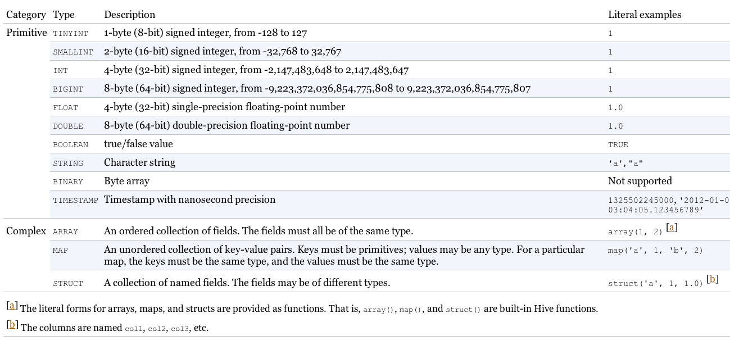
Data Types

Slide 18
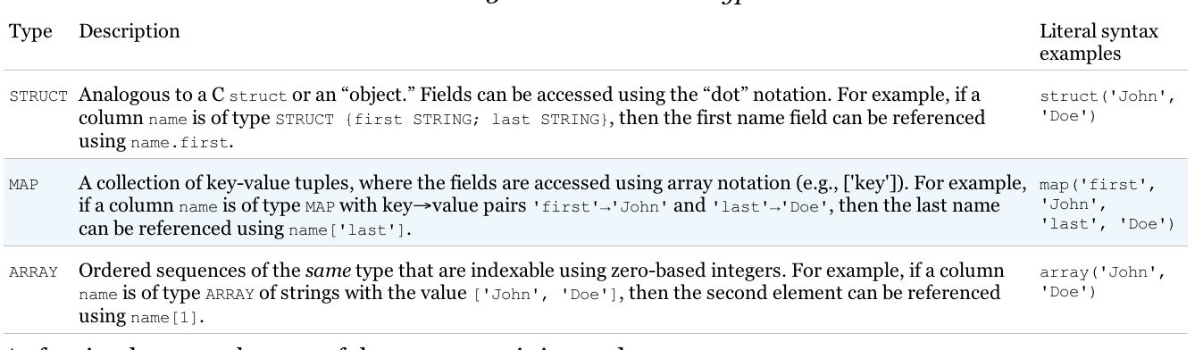
Complex Data Types
Most relational databases don’t support complex data types since they tend to break normal form.
  For example structures in relational DB are usually captured in separate tables with foreign keys, etc.
Breaking normal form results in data duplication
  More disk consumption
  Data inconsistencies

Slide 19
Normal Form Example
Student ID | Student First name | Student Last name | Email
Subject code | Subject Name | Lecturer Name | Semester
Student ID | Subject Code
The above is an example of a schema which conforms to normal form.
Typically relational databases use the above schema since it means there are no data duplication.

Slide 20
Complex Data Types
For Big Data
  Data are normally not updated
  We get better performance by sacrificing normal form
    Less need to join tables
    Embedding collections inside records minimizes seeks.
    Navigating each foreign key relation requires seeking across disk and/or getting data from other nodes.
    Can directly use data files that are not in normal form without needing to first load the data into the database.

Slide 21
Complex Data Type Example
Subject code | Subject Name | Lecturer Name | Semester | Array of students
CSE3BDC | Big data management on the cloud | Zhen He | 1 | [<9198, Peter, Smith, p.smith@gmail.com>, <9291, John, Wilson, j.wilson@gmail.com>, etc.]
We can imagine the above is from a file that contains the class list of students for each subject in the university.
Hive does not need to touch the file but instead just needs to impose the above schema on the file as the file is read from the disk.
For example when a student changes his/her email address the above schema causes a problem since all entries that contain that student need to be updated. However, typically when we doing data analytics (typical use for Hive and MapReduce) data is never updated.

Slide 22
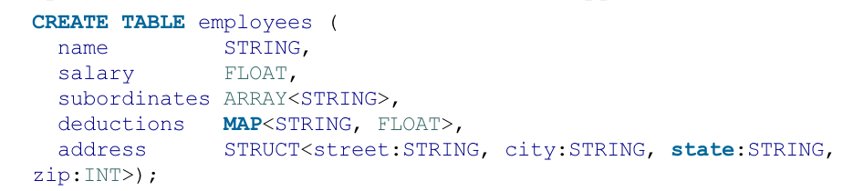
Complex Data Types
We can treat the name as a primary key
Subordinates would reference another record in the table.
Deductions is a map that holds a key-value pair
  Every deduction has a name (e.g. “Federal Taxes”) and the percentage of deduction (e.g. 10).
  For traditional DBs this map would be stored in a separate table.
Address is stored as a separate struct.
Java syntax conventions for generics are followed for the collection types.
  E.g. MAP<STRING, FLOAT>, ARRAY<STRING>

Slide 23
Creating Tables and Loading Data
Remember Schema on Read?
  Loading data just involves copying file instead of inserting data into DB a line at a time.
  Very fast
  No checking if the file conforms to the schema
    Can get a nasty surprise when querying data later.
When you load data into a table created in Hive it is moved into Hive’s warehouse directory
In the above example the file hdfs://user/tom/data.txt will be moved into warehouse directory for managed_table table, which is hdfs://user/hive/warehouse/managed_table

Slide 24
Dropping data
When a table is dropped its metadata and data are deleted.

Slide 25
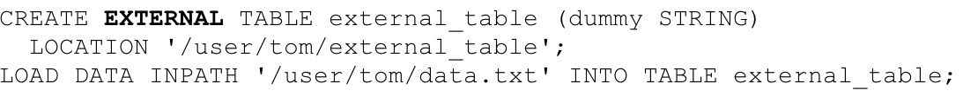
External Table
Hive will just update its metadata to say this table resides in the external directory/file you have specified
It will not even check that the file actually exists
  Allows you to lazily create the data after creating the table.
When the external table is dropped, Hive will leave the data untouched and just delete the metadata

Slide 26
When to Use External Table?
If you are using Hive and other tools on the same dataset
A common pattern
  Use an external table to access an initial dataset stored in HDFS
  Transform data and store into managed Hive table
    Transform data: dropping some columns
    Transform data: dropping some rows
    Etc.
External table can also be used by Hive to export data.
External table can be used to associate multiple schemas with the same dataset.

Slide 27
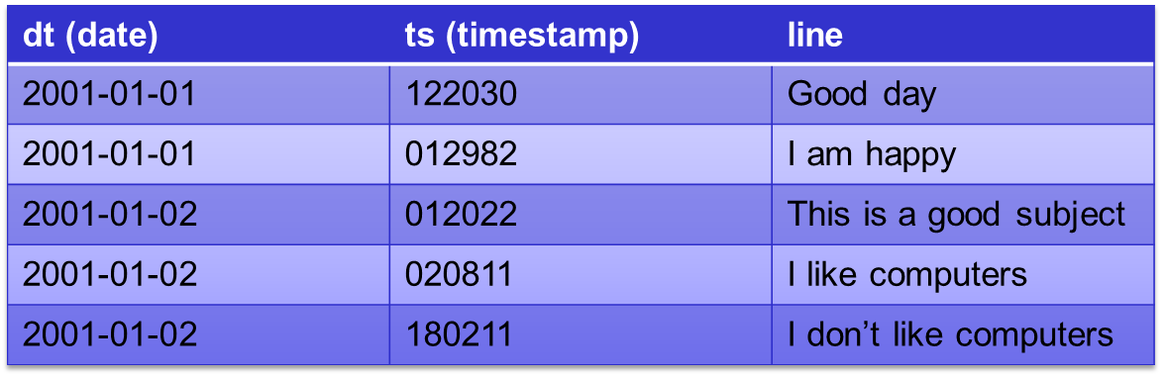
Partitions
P1
P2
Hive allows you to horizontally partition a table into multiple files.
  One file per partition
  The data for each partition is physically stored in separate locations.
This way it will be faster to lookup data.
For example a query that is just interested in data for 2001-01-01 will only need to access one file containing only data with date 2001-01-01.
For the above example we can create the table as follows:
  CREATE TABLE logs (ts BIGINT, line STRING)
  PARTITIONED BY (dt STRING);
We can then load a file into one of the partitions as follows:
  LOAD DATA LOCAL INPATH ‘input/hive/partitions/file20010101’
  INTO TABLE logs
  PARTITION (dt = ‘2001-01-01’);

Slide 28
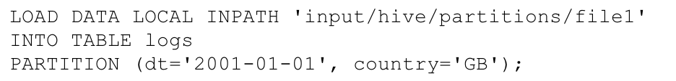
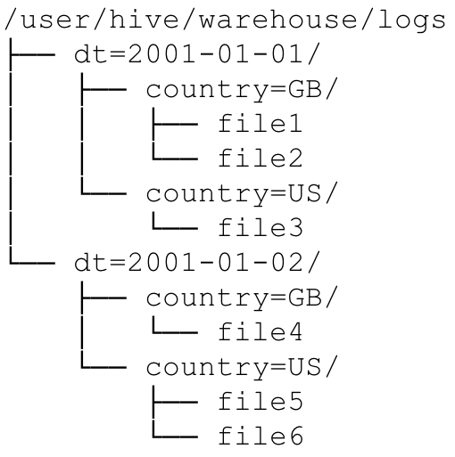
Partitions
We can partition the data by more than one field.
The Hive directory structure for the above example is the following:

Slide 29
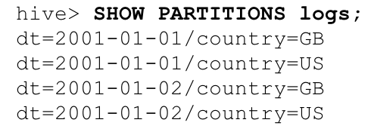
Show Partitions in a table

Slide 30
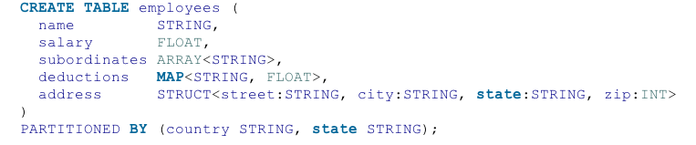

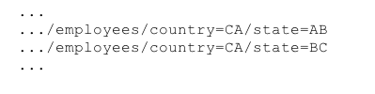
The partitioning attribute does not need to be inside the table itself
Note the country and state columns do not need to be stored inside the table itself. This information is actually encoded inside the directory names themselves.
So when we search for country = ‘US’ and state = ‘IL’ we do not need to look for these values inside the table since it should be encoded inside the directory names themselves.

Slide 31
Partitioned table logically includes the partitioned column
CREATE TABLE employee(emp_id INT, name STRING) PARTITIONED
BY(country STRING);
Actually creates a table that logically contains the country column like the following.
CREATE TABLE employee(emp_id INT, name STRING, country STRING)
So we can then write queries like
SELECT emp_id, country FROM employee
WHERE country = ‘Australia’

Slide 32
Partitions
You may have the following question
  What if we all my data is in one file and we want to split it into different partitions?
The answer is you can not use the Load command since load just copies files into Hive directories.
  It can not split a file into multiple files.
See the next slide for the solution

Slide 33
Partitions using INSERT
CREATE EXTERNAL TABLE staged_employees (cnty STRING, st STRING)
LOCATION ‘/user/tom/external_table’;
LOAD DATA INPATH ‘/user/tom/data.txt’ INTO TABLE staged_employees;
CREATE TABLE employees (cnty STRING, st STRING)
PARITITIONED BY (country STRING, state STRING);
INSERT OVERWRITE TABLE employees
PARTITION (country = ‘US’, state = ‘OR’)
SELECT * FROM staged_employees se
WHERE se.cnty = ‘US’ AND se.st = ‘OR’;
In the above example we first create an external table called stage_employees and then link our external input data with it.
Next we create a partitioned table called employees
Next we select all the rows of the staged_employees table which have the country set to US and state set to OR into the corresponding partition in the employees table.
The OVERWRITE command overwrites the previous contents of the partition as it inserts the new tuples.

Slide 34
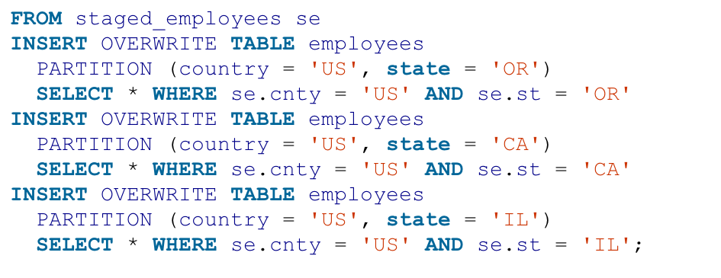
Partitions using INSERT
We can write the above to insert data into the other partitions.
But the above is quite tedious, we have 52 states for the US we would need to write 52 more INSERT statements just for the US alone.
Is there a better way?

Slide 35
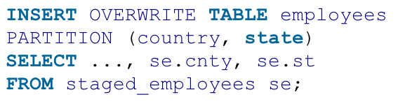
Dynamic Partition Inserts
The above example infers the partitions to create based on query parameters.
Hive determines the values of the partition keys, country and state, from the last two columns of the SELECT clause.

Slide 36
Append
We can append a row into a table without overwriting it by using
  INSERT INTO TABLE
  Instead of
  INSERT OVERWRITE TABLE

Slide 37
Buckets (clustering)
Tables or partitions can be split into buckets
Bucketing effectively hash partitions the data.
Three reason for using buckets
  Partitioning sometimes produces too many files (overwhelms the file-system)
    Use bucketing to produce less files.
  Enable more efficient queries
    In particular joins are more efficient
    We will demonstrate this soon.
  More efficient sampling.
The above example splits the table buckets_users into 4 buckets
  Rows are placed into buckets based on the user id attribute
  It will use a hash function to determine which user ids go into which bucket
  Rows will be effectively placed evenly into the buckets

Slide 38
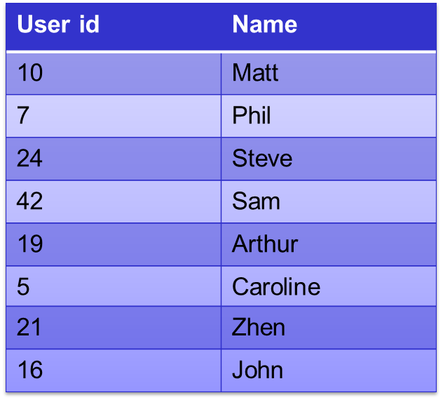
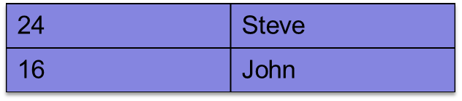
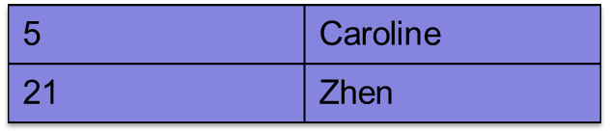

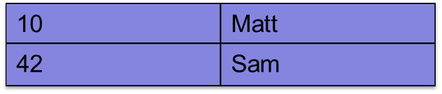
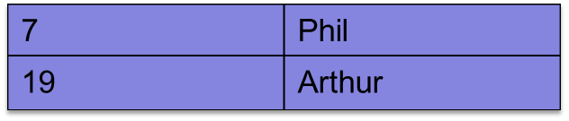
Buckets
Bucket 0, filename: 00000_0 contains
Bucket 1, filename: 00000_1 contains
Bucket 2, filename: 00000_2 contains
Bucket 3, filename: 00000_3 contains
The above command takes the users table and writes the rows into our bucketed_users table.
Each bucket will store the data in a different file.
In this example we are using the following simple hash function:
User % 4

Slide 39

Too many files using partitioning
This create table command would create too many directories if there are many different users for each date (dt).
  The reason is it creates one directory per dt, user_id pair.
Hive will not let you create any more directories after a certain limit has been reached.
We can reduce the number of directories produced by using bucketing for the user_id attribute.
In the above example we limit the number of buckets used to store user_ids to just 96.

Slide 40
Buckets good for join
If both tables involved in a join are split into the same number of buckets on the join attribute then we can do a map-side join.
  Note this is different from both the replicated join and reduce-side join we talked about earlier.
The map-side join is faster the normal replicated join since no reducers are needed.
  The map side join is a hint embedded into an SQL C-style comment.

Slide 41
Data sorted in Buckets
The data in buckets can be sorted by one or more columns
If the data is sorted within buckets then the map-side join can be even more efficient
  Merge join per bucket

Slide 42
Buckets good for sampling
Sampling is much quicker after the data is in buckets.
Assume for the above example the bucketed_users table is clustered into 4 buckets.
For example if we just want to take a 25% sample of the data we just use the first command above.
  It just involves taking the rows in one of the 4 buckets.
Similarly if we want to take a 50% sample we just need to use the second command
  It just involves taking the rows in two of the 4 buckets.

Slide 43
Storage Format
Hive supports row format and file format
Row format
  store data in Hive internal format, like what databases do
    Super optimized
  Dictates how rows and fields are stored
  SerDe – Serializer-Deserializer
    Deserialize a row from bytes into Hive internal representation of the row as an object
    Serialize does the opposite to the deserializer
    Reads data in using Hadoop input format and the deserializes using SerDe.
    Allows attributes to be deserialized lazily
  Compression available

Slide 44
Storage Format
File format
  Makes Hive compatible with the rest of Hadoop.
    Can read data outputted from MapReduce
    Can write data that can be read by MapReduce.
  Many different formats available
    Text file
    XML, JSON formats
    Sequence files (Hadoop objects stored in binary format)
      Compression option available
    Row-oriented binary format
    Column-oriented binary format

Slide 45

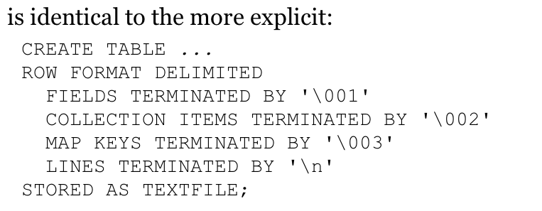
Default Storage Format
Default storage format is delimited text with one row per line
Default field delimiter is not tab but Control-A (^A)
Default ARRAY or STRUCT delimiter is Control-B
Default map key delimiter is Control-C
Default row delimiter is the newline character.
By default SerDec uses LazySimpleSerDe.
  This means it only deseralizes a field when it is accessed.

Slide 46
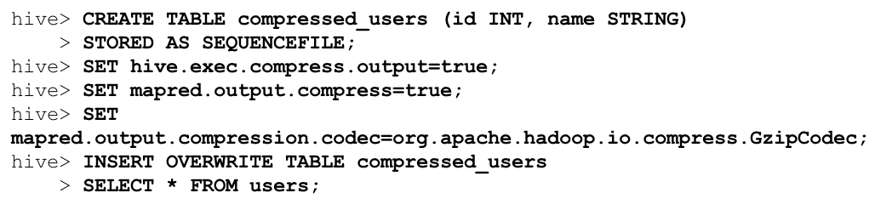
Binary storage formats: Sequence files
Hadoop’s sequence file format is a general-purpose binary format for sequence of records (key-value pairs)
  STORED AS SEQUENCEFILE
One of the really nice things is that you can compress sequence files like below

Slide 47
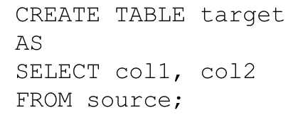
Create Table As Select
Creates a table based on the result of a query

Slide 48
Querying Data in Hive

Slide 49
Sorting
ORDER BY is used for producing globally sorted data
  However, can be slow since it uses just 1 reducer to produce a total sort
  Newer versions of Hive will improve on this.
If we are happy with data just stored within each reducer but not globally sorted.
  Then use SORT BY
  This is much faster than ORDER BY since we can use more than 1 reducer.

Slide 50
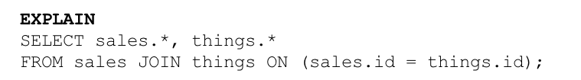
Explain
You can get Hive to show you the query execution plan using the EXPLAIN command.
More detailed execution plan is available using
  EXPLAIN EXTENDED

Slide 51
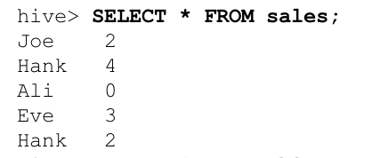
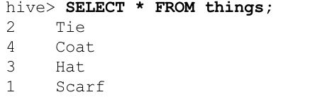

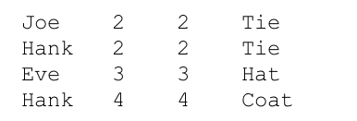
Inner Join
Inner joins are easy, see above

Slide 52
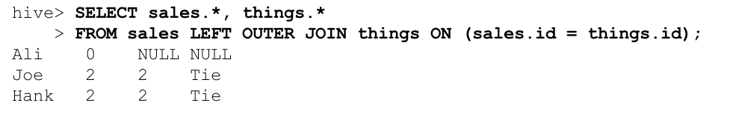

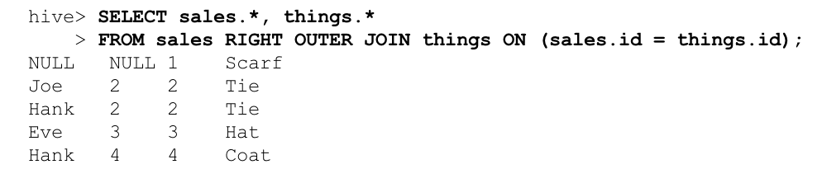
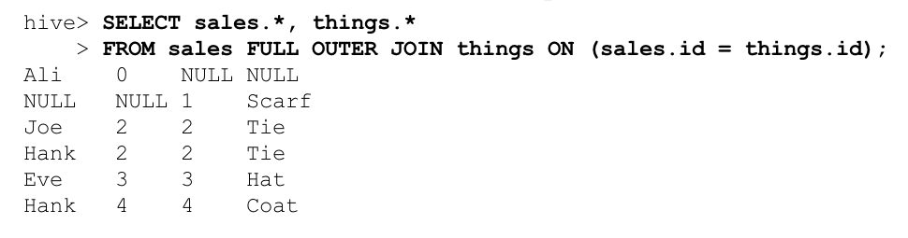
Outer Joins

Slide 53
Subqueries
Subqueries are supported in both the FROM and WHERE clause.
Here is an example of subqueries in the FROM clause
SELECT col
FROM (
SELECT a+b AS col
FROM t1
) t2
In the above example a subquery is used in the FROM clause to create temporary table which is used by the outer query.
The AS keyword is used to give a name for the column inside the temporary table.

Slide 54
Subqueries
SELECT col1, col2
FROM table1
JOIN (
SELECT col3, COUNT(col1) AS c1
FROM table1
GROUP BY col3
SORT BY col1
LIMIT 15
) myt ON table1.col3 = myt.col3;
Example of Hive supporting join queries from the FROM clause

Slide 55
Subqueries in WHERE clause
SELECT state, net_payments
FROM transfer_payments
WHERE transfer_payments.year IN (SELECT year FROM us_census)

Slide 56
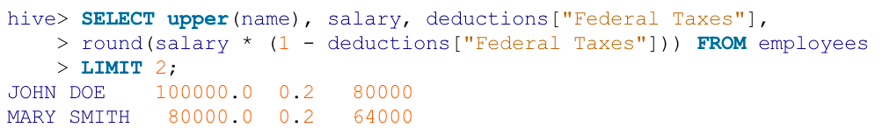
Limit
The limit clause can be used to limit the output to a maximum number of rows.

Slide 57
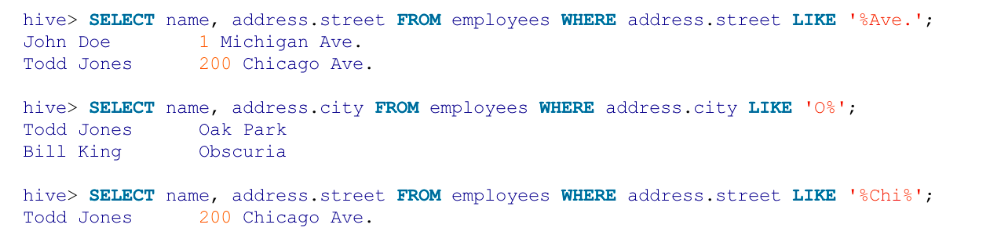
LIKE
The same as SQL, Hive also supports the LIKE clause for matching strings.
The above examples
  Matching strings that end in Ave.
  Matching strings that begin with O
  Matching strings that contain Chi anywhere

Slide 58
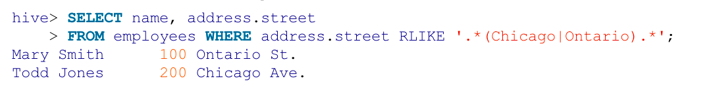
RLIKE
Hive supports RLIKE which allows the user to use Java regular expressions to match strings
In the above examples a Java regular expression is used to match all strings that contain either Chicago or Ontario somewhere in the string.
This is the same as the following query using the standard Like

Slide 59
User Defined Function
UDFs are written in Java
Three types
  Regular UDFs
    Operates on a single row and produces a single row as output
    E.g. math functions like ABS, TAN, COS, etc.
  UDAF
    User defined aggregation functions
  UDTF
    User defined table generating functions

Slide 60

User Defined Aggregation Functions (UDAFs)
Input: multiple rows
Output: single row
E.g. count, max, avg

Slide 61
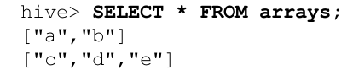
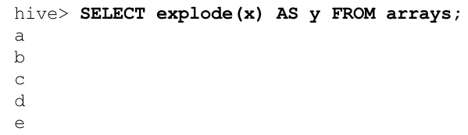
User Defined Table Generation Function (UDTF)
Input: single row
Output: multiple rows (table)
The explode function is a UDTF that takes an array of input and iterates through the list, returning each element from the list as a separate row
The output column is y which is of type STRING

Slide 62
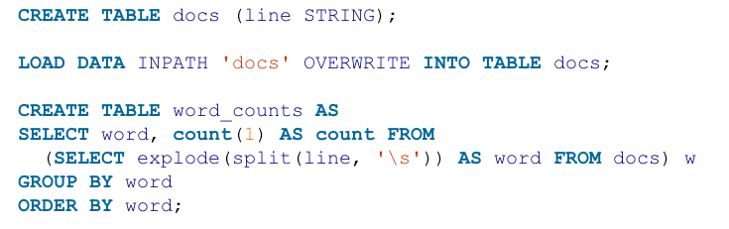
World Count using HiveQL
Notice the use of explode UDTF.
The query first takes each line of input, splitting it into an array of words which is then fed into explode
  Explode then takes each word within the line and places it into a separate table.
Next we group and order by word and report a count for each word.

Slide 63
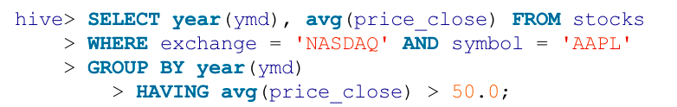
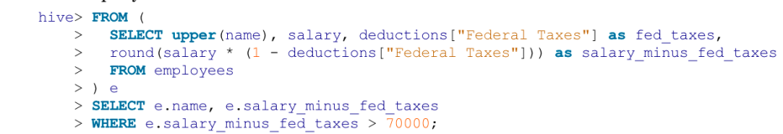
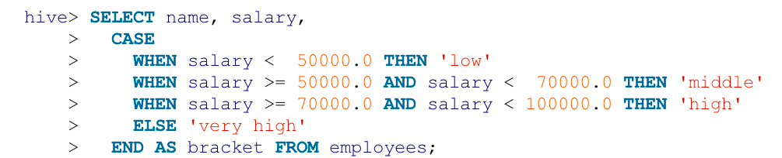
The rest
The rest is pretty much the same as normal SQL.
Try stuff and see what happens

Slide 64
Conclusion
In this lecture we learnt:
  Some nicer ways of writing MapReduce programs.
    Pig and Hive
  Remember the programs your write in Pig and Hive are ultimately converted to MapReduce when executed on the cluster.

